Slide 1
Classification of Requirements

Slide 2
Requirements: Two Types
Functional Requirement
  What is solved by the application?
Non Functional Requirement
  Qualities
    Expectation from the application
  Constraints
    Things that can not be changed

Slide 3
Requirements : Functional Requirements
Functional requirements describe what the system will do from a number of perspectives
  How: Business functionality - What the system has to do “inside”
    Captured directly (such as use case model) and indirectly (business process model)
  “Who” and “where”: Users – What the system’s users can do, and where they are
    How competent are the system’s users, and how/where do they access the system?

Slide 4
Requirements : Functional Requirements
Functional requirements describe what the system will do from a number of perspectives
  “What”: Data – What does the system “know,” and what else does it need?
    Is all the necessary information “inside” the system, or does it require data access elsewhere?
  “With”: Integration – What the system has to do “with other systems”
    “Other systems” may be IT or human

Slide 5
Requirements : Functional Requirements
Business and System Requirement
Typical Representations/Sources
  Customer wants and needs
  Business process model
  Business rules
  Use Case/Use Case Model
  User Story/Epics

Slide 6

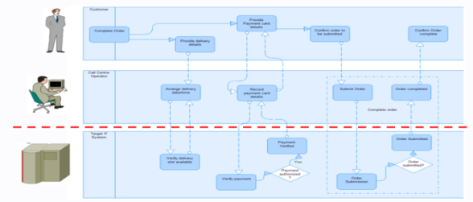
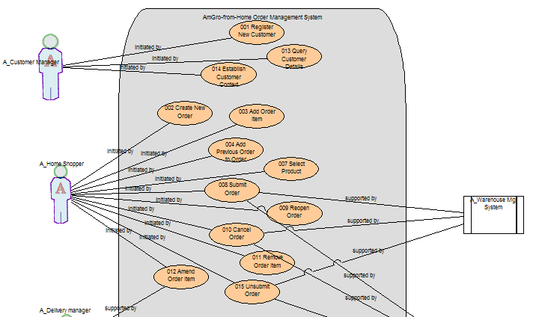
Requirements : Functional Requirement Models
Human actor
Target system
Use
cases

Slide 7
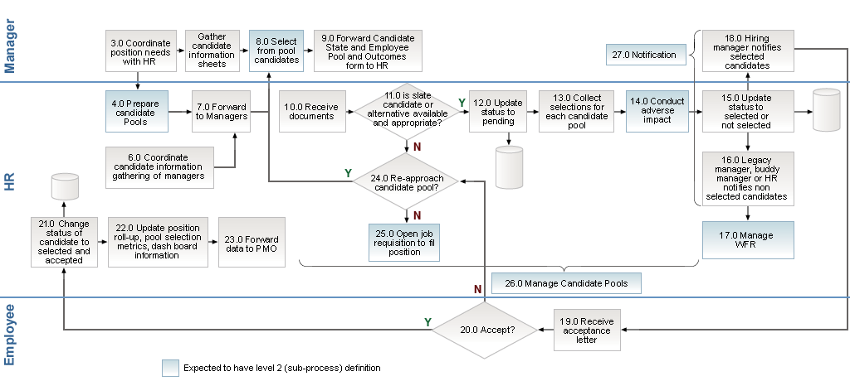
Requirements : Functional Requirement Models

Slide 8
Requirements : Non-Functional Requirements
Qualities
  Expectations and characteristics the system should support
    The “adjectives” that can be applied to describe the functional requirements
      Can be associated with the execution
        How secure, how fast, how many users…
      Can be associated with other aspects
        How portable, how scalable, how safe…

Slide 9
Requirements : Non-Functional Requirements
Constraints
    Limitations or specification imposed
      “It must be done this way.”
      “It must conform to this legislation.”
      “We only have skills in these areas.”
    Technical
    Business

Slide 10
Requirements : Non-Functional Requirements
Runtime
  Can be empirically tested
  Also known as observable
  Provide value to user
Non-Runtime
  Can not be measured easily
  Also known as non-observable
  Provide value to operator

Slide 11
Requirements : Runtime NFRs
Performance
  How does the system respond to user actions ?
  How does the system support suitable numbers of concurrent users ?
  How does the system support enough transactional throughput ?
Capacity
  Is the system capable of storing/ processing expected volumes of data ?
  Is the system capable servicing expected number of users ?
Availability
  What is the maximum length of unscheduled outage the business can tolerate ?
Security
  Can the system identify and prevent unauthorised access?

Slide 12
Requirements : Runtime NFRs
Manageability
  How straightforward the system is to maintain ?
Usability
  Do the system’s user interfaces measure up to best practice usability benchmarks ?
Accessibility
  Can visually-challenged or hearing-impaired people use the system ?

Slide 13
Requirements : Non-Runtime NFRs
Portability
  Moving the application to other operating systems, or containers or hardware
Maintainability
  How easy is to change the system, whether for bug fixes or to add new functionality
Manageability
  Ease with which the system can be reused, deployed, and tested, started up, and shut down
Scalability
  How easily the system can be expanded to accommodate growth in the future
Efficiency

Slide 14
Requirements : Non-Runtime NFRs
Data Integrity
  Data is consistent throughout the application
Environmental
  Whether the system will harm users
    physical harm, as in medical systems
    financial harm, as in accounting systems
    or other forms of harm
  How well the system utilizes resources, and its effect on the environment
Reliability
  The probability that a component will fail, and the nature of that failure
Compliance
  Whether it conforms to the regulatory environment,

Slide 15
Requirements : Technical Constraints
Legacy Integration
Development Skills
Existing Infrastructure
IT Standards
Implementation Constraints

Slide 16
Requirements : Business Constraints
Time
Resource
Scope
Risk Willingness
Regulatory
Geographic
Organizational

Slide 17
Requirements : Five most important NFRs
Performance - Without this users won't be able to use the system
Availability - Without this users will stop using the system
Security - Without this "users" will stop the system being used
Scalability - Without this users sometimes won't be able to use the system
Legacy Integration - Without this system will not be able to use other systems

Slide 18
Requirements : Performance
How fast.. how big... how often...
A simple performance statement, such as “a response time of less than 1 second,” is insufficient
  What is the performance requirement (response time, transaction time)?
  When is it to be delivered (in defined service hours)?
  Where is it to be measured (on which systems, using which tools)?
  For what workload is it to be valid (are test transactions available)?
  For which users or systems (and how many)?
  How can you define the percentile to achieve the given value (95th percentile, average)?

Slide 19
Requirements : Availability
Measure of readiness for usage
  System may be unavailable
    Scheduled outage
    Unscheduled outage if something breaks
High Availability
  System is available when it is expected to be
Continuous Operations
  Intended to be available 24X7
Continuous Availability
  Always available all the time
Measured as % uptime during scheduled hours
  95% 99.9% 99.99% etc...
  Meaning need to be identified based on system type

Slide 20
Requirements : Security
Safety, protection, assurance
Authentication – User is valid
Authorisation – User has right to do what he or she is doing
Integrity – Protection from unauthorized update
Confidentiality – Protecting data from unauthorised disclosure
Non-Repudiation – Strong evidence of authenticity of sender and receiver of any message/data

Slide 21
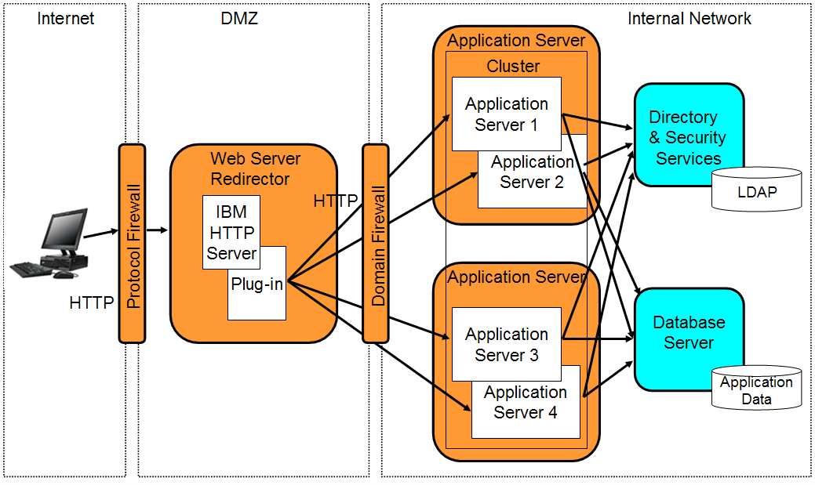
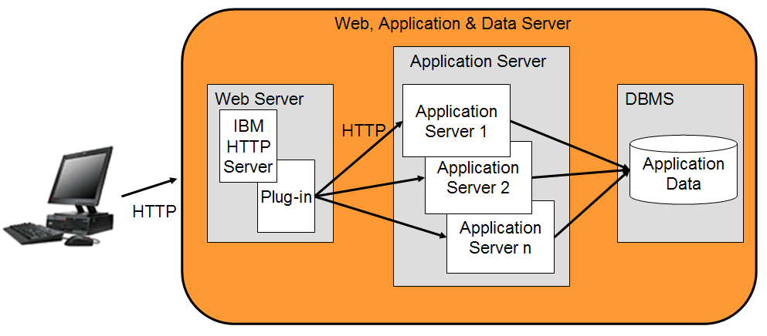
Requirements : Scalability
Ability to change in size according to changing workload such as change in user numbers
Horizontal scaling
Vertical scaling

Slide 22
Requirements : Legacy Integration
Need to integrate with other systems

